Slide 1
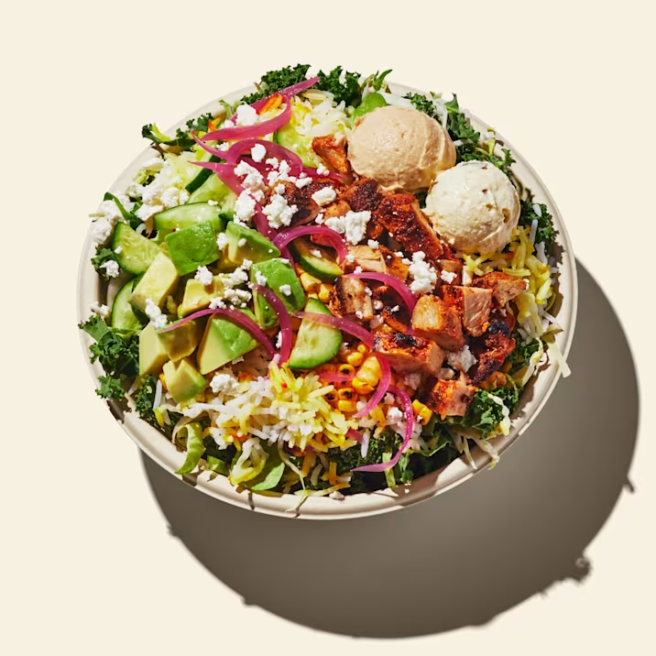
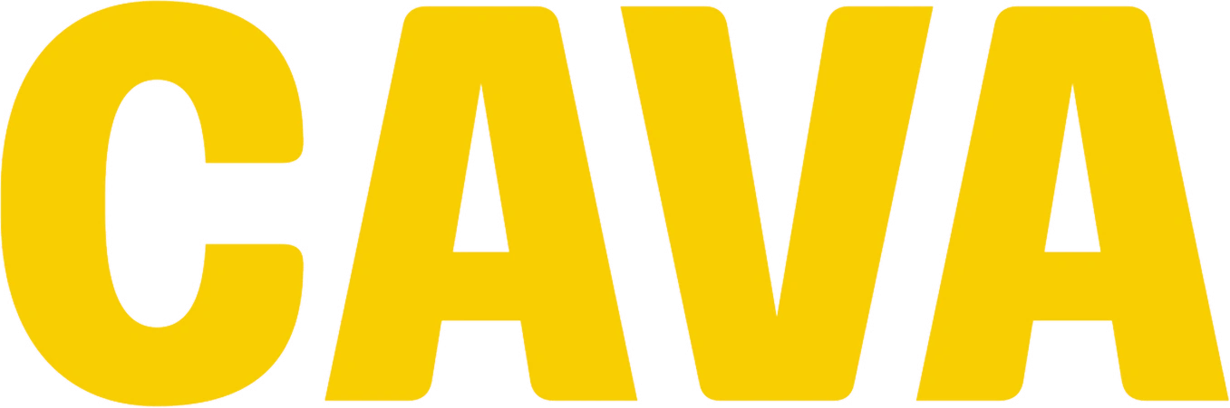
The Distributed
Cognition of
A Fast Casual Business Analysis
By David Doctor

Slide 2
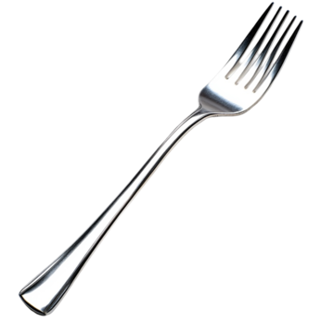
Project Overview
Why CAVA?
Expectations
I chose this fast casual restaurant as it was and still is a favorite establishment for me to eat at. Cooking and assembly of the bowl is done in front of the customer so it’s also very easy to analyze all the operations within the restaurant.
As I’ve been here many times before I already know how the ordering process works. Kind of like Chipotle and Qdoba, this place uses an assembly line type of system where you work your way down through various toppings to create your bowl and receive your food at the end of the line where the cashier rings you up.

Slide 3
Project Overview
What do they produce?
What task did I observe?
What was my role in the information system?
Cava Grill makes custom made Mediterranean bowls with in-house made drinks, sides, and desserts. They offer catering services and delivery as well
I observed how orders were made, how signs convey information to both staff and customers, and how cooks and team members manage their workspace.
My role in the information system was the customer. Just like everyone else, I ordered my own custom bowl and ate it in store, although I have noticed that most people do tend to take-out

Slide 4
Research Method
Date & Time
Observation Method
Data Generated
I first visited Cava Grill on a weekday at around 6PM as this was around dinner time and I would be able to see how it can operate during peak hours and plenty of staff and customers. I visited the establishment on Tuesday February 11th 6PM, and a second time on February 12th at 3PM.
I was able to take and enjoy my own order while taking pictures of the establishment. I also walked around and sketched out a map. Unfortunately they did not allow me to go into the back to take more pictures.
I took pictures, sketched a map, and ordered from the restaurant

Slide 5
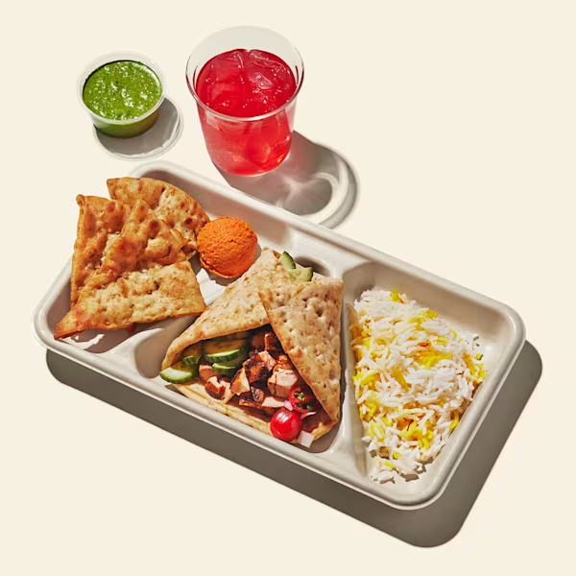
Research Data

Slide 6
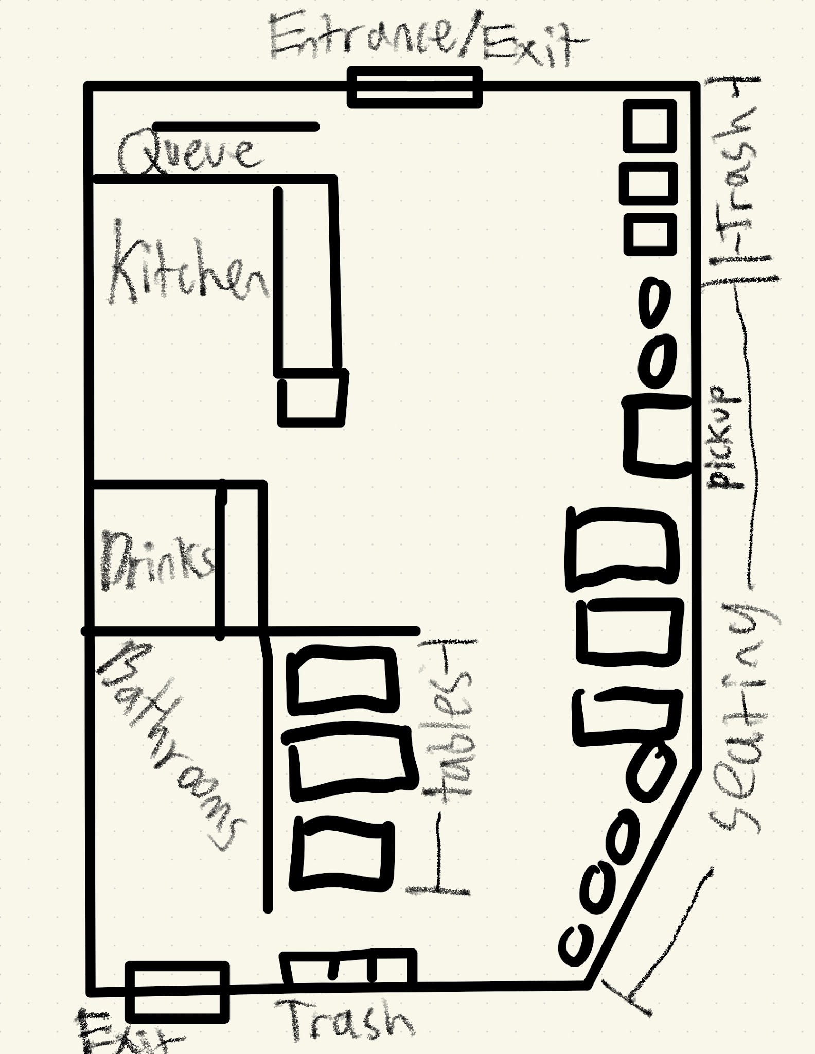
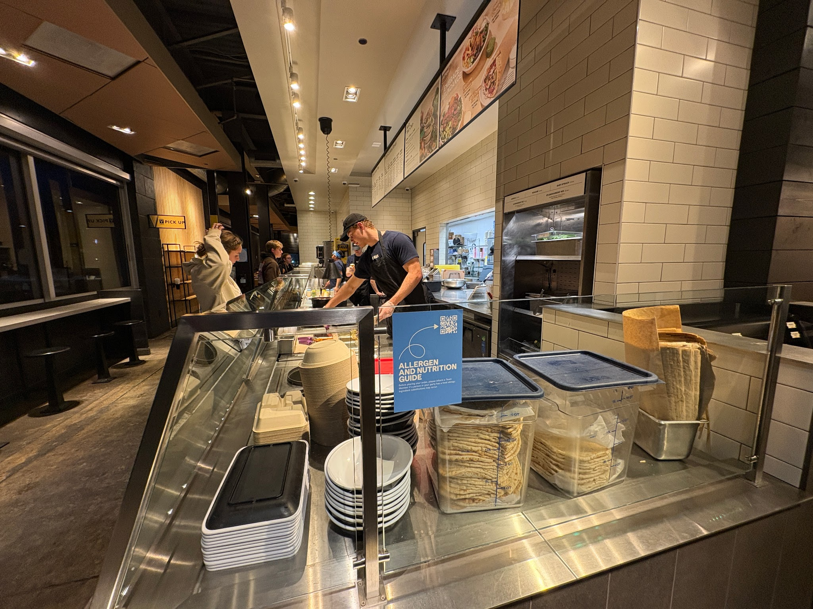
Layout

Slide 7
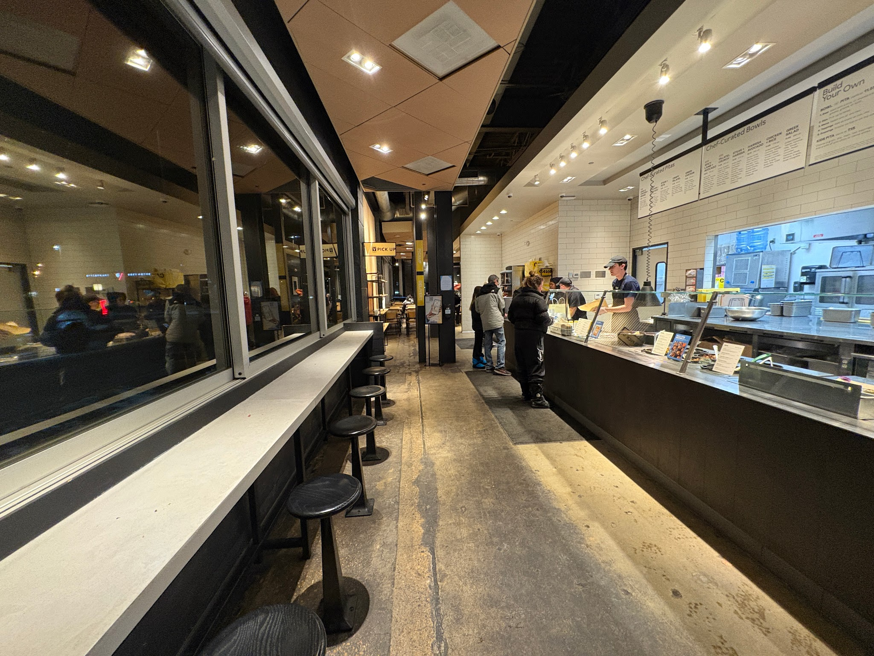
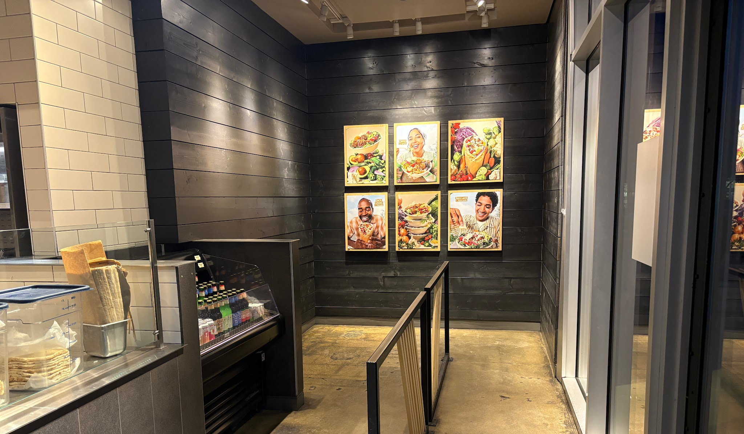
Entrance
Entering immediately shows you the ordering counter and the menu, or if you want to meet up with friends or pick up an order, you can walk straight ahead and head to those areas of the store
This corner is specifically for when there’s a long line and allows people to form a queue on their own, the barrier is permanent and conveys the information of being used for a queue. The drinks on the side also allows people to grab a drink while waiting in line.

Slide 8
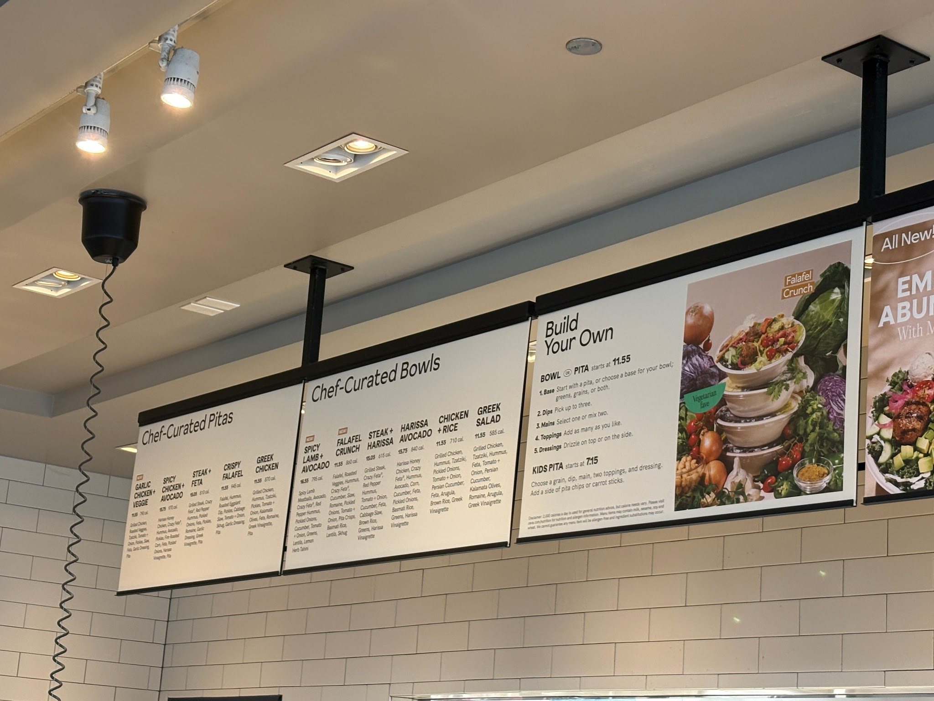
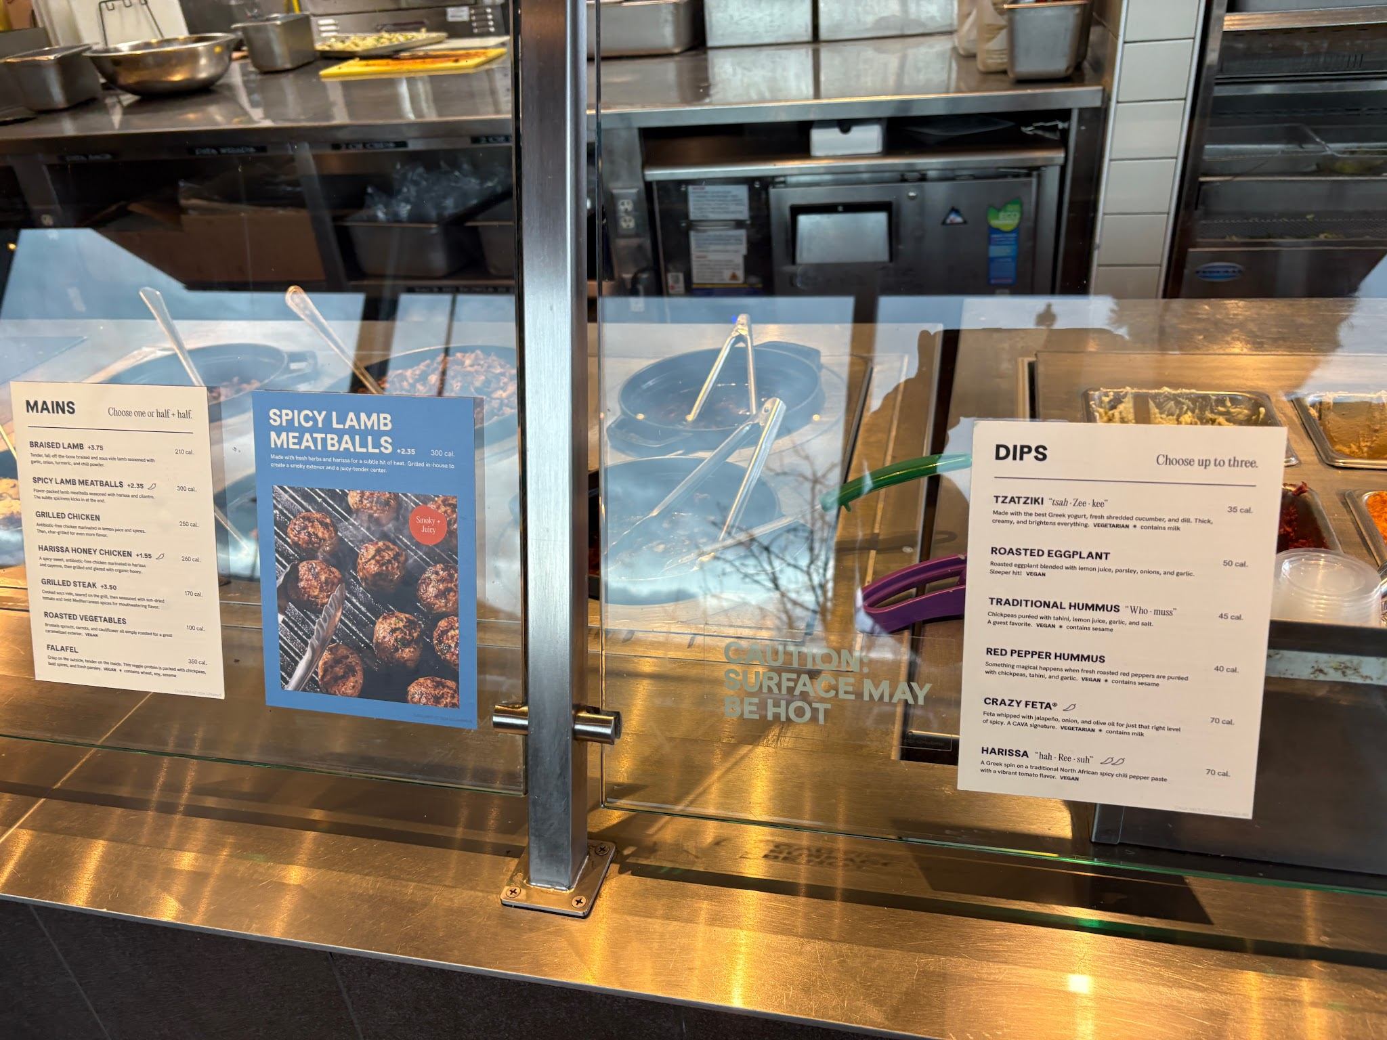
Menu
The menu has two parts, the Chef-Curated and Build Your Own. The Chef Curated section of the menu shows both Pita and Bowl options, with the name of the item, the price, calorie count, and description of the item. It of course, separates the menu by Bowl and Pita. The Build Your Own section shows the price, allows you to pick your base and shows what the steps are to building your dish. Along the assembly line there are mini menus that show what your options are for dips, meats, etc. Each topping has calorie information, spice level, description, and a fun-fact about pronunciation.

Slide 9
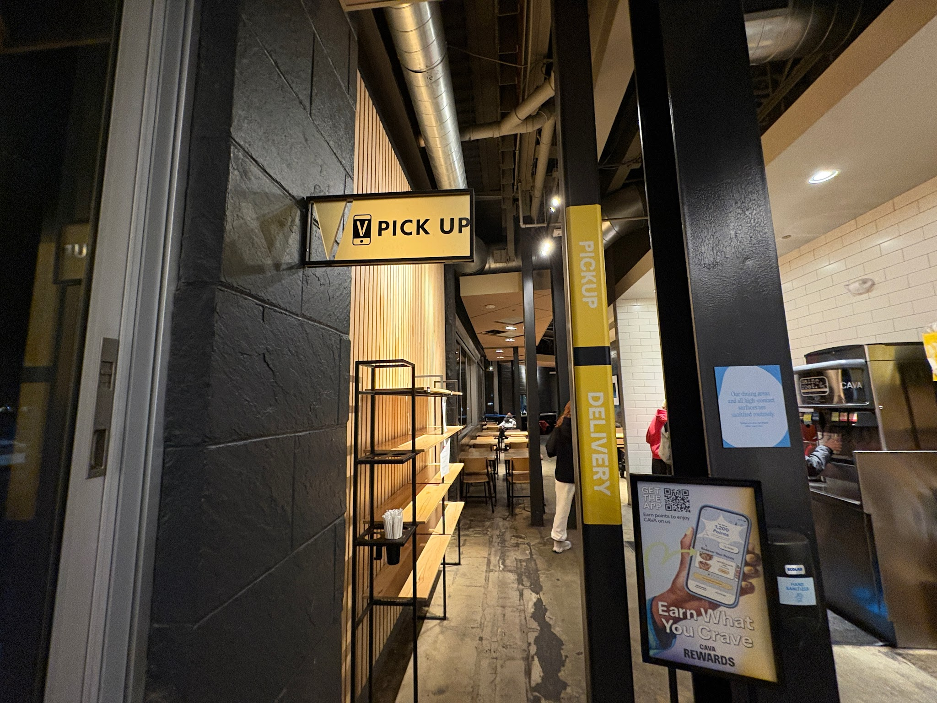
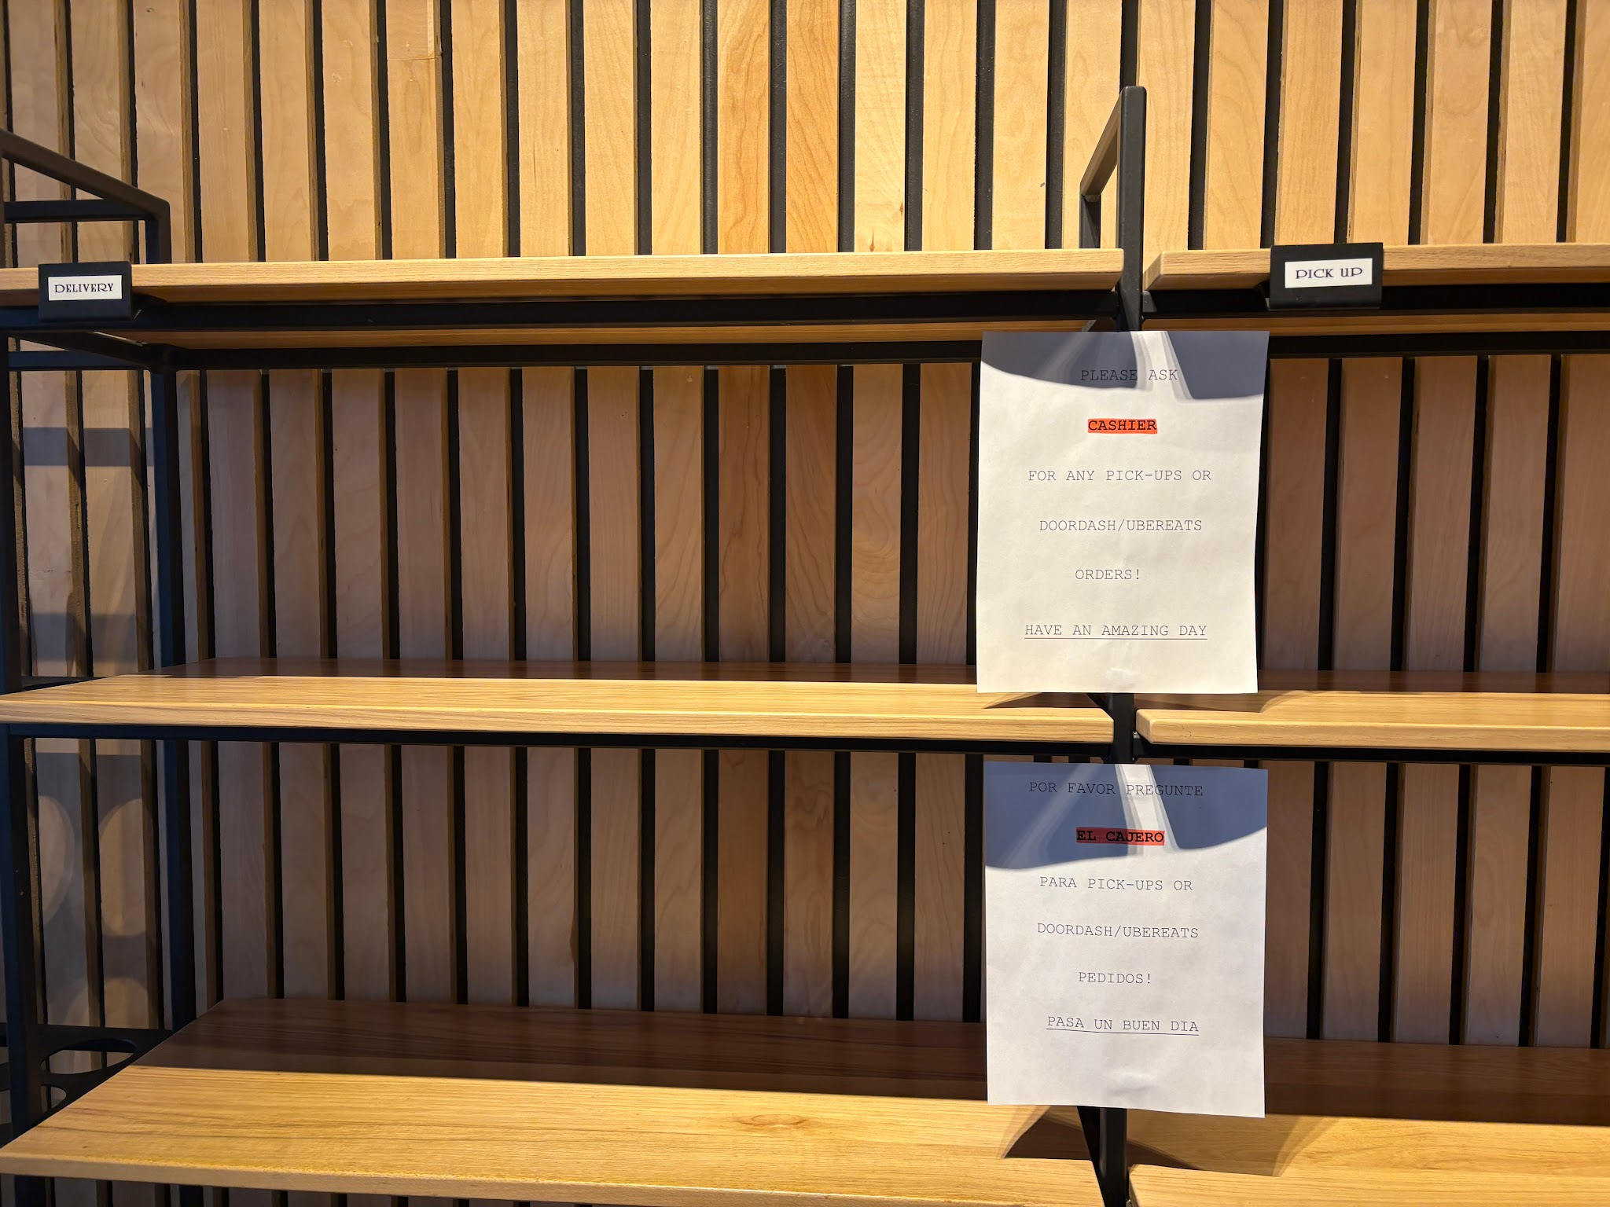
Pickup
The Pickup Shelf is clearly marked with yellow signage and stickers along the nearby pillar. The shelf is then split into two sections, one for pickup and another for delivery where GrubHub and other drivers can grab their orders without asking. There is also additional information posted on paper for the delivery drivers in the event that delivery orders aren’t on the shelf. The papers are in both English and Spanish

Slide 10
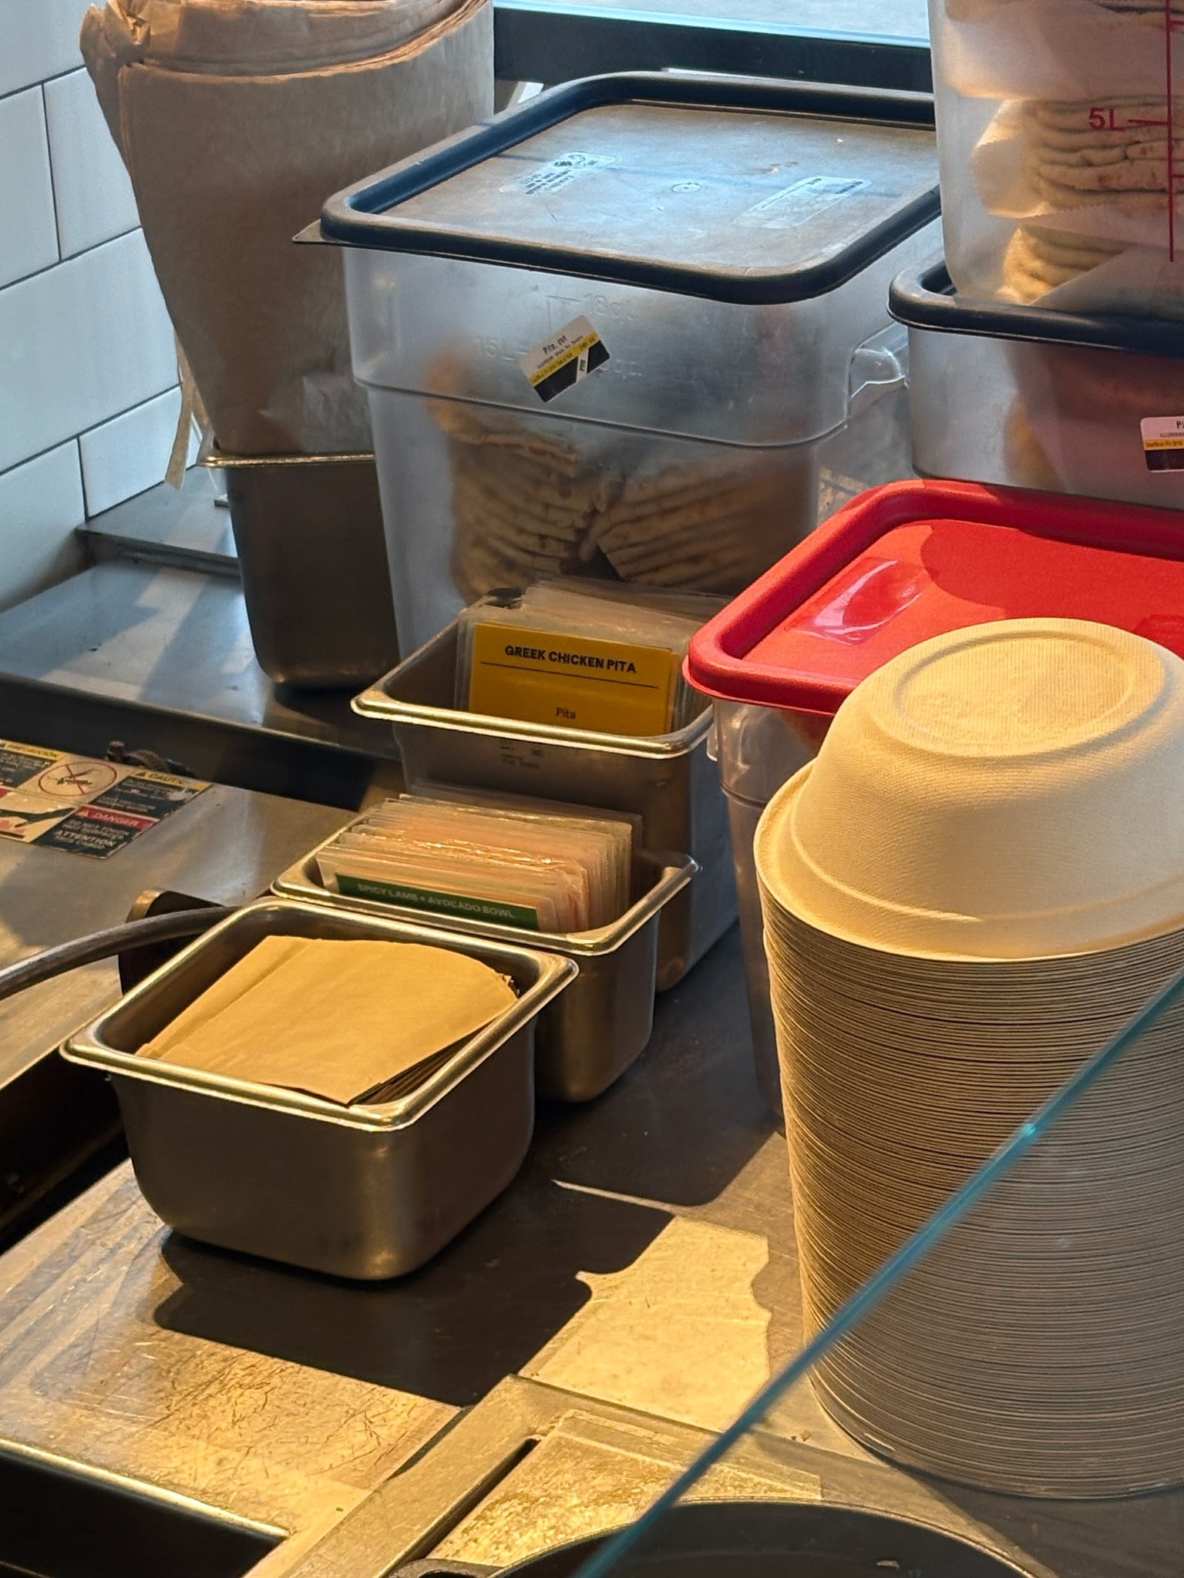
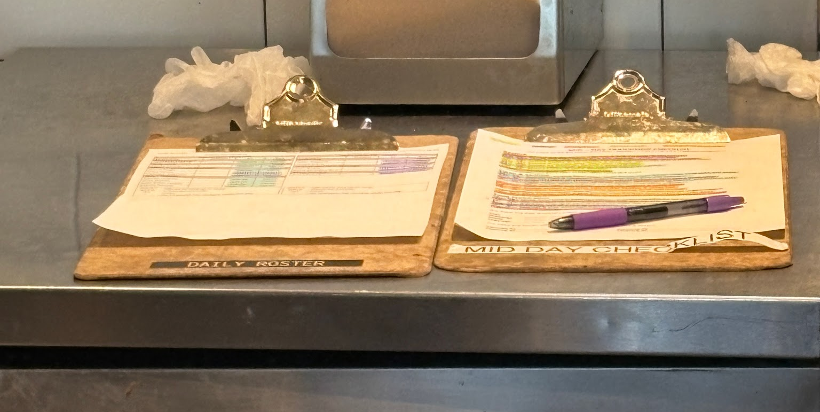
Employee Guides
Unfortunately I was unable to get behind the counter to gather more insight on the employee guides scattered around the kitchen but based off what I was able to infer from investigating from the front, employees are given a daily roster to keep track of shifts during the day, a mid-day checklist to keep track of tasks (this also implies that there’s a checklist for evening and morning shifts), and various laminated cards to help employees to build or prep certain dishes

Slide 11
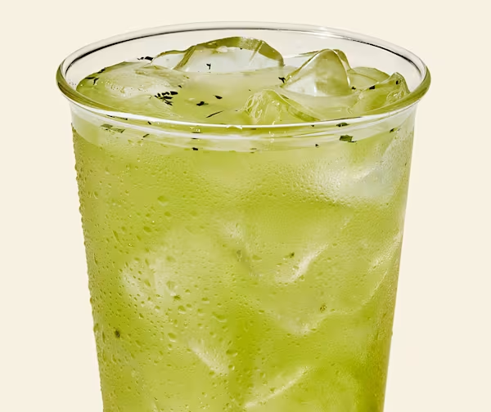
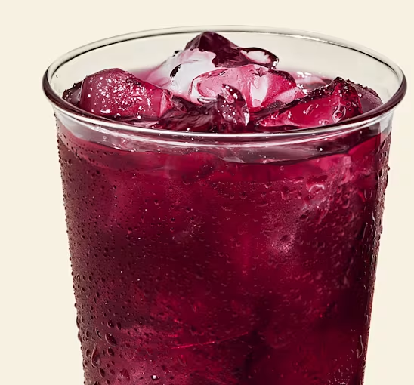
Analysis

Slide 12
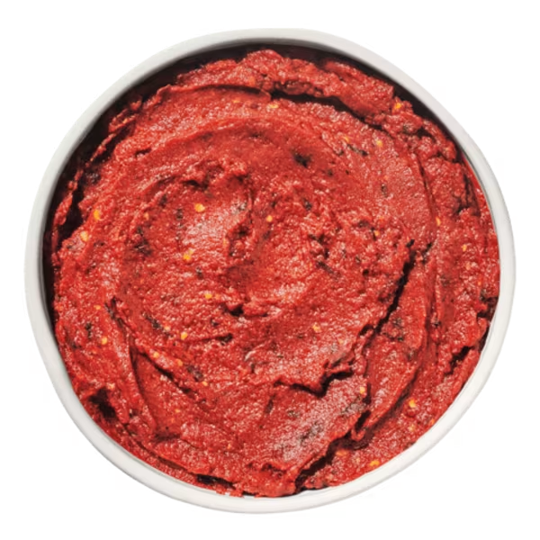
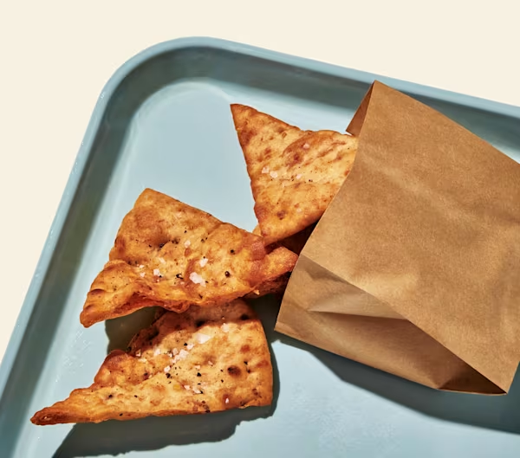
What is being produced
What is the main task being accomplished?
The main task here is custom Mediterranean bowls. Each customer has the option to build their own bowl from a variety of options for toppings or pick from a pre-set bowl on the menu. Drinks and sides like pita bread are also available at request

Slide 13
Social Space
What is the division of labor to get it accomplished?
Who are the actors involved?
Customer enters and waits their turn in the queue space
Customer is greeted by a team member at the counter, where they are able to request which type of bowl they want
That team member adds the bowl’s base, dips, and meats before passing the bowl to the next team member
This team member puts on any additional toppings and dressings before checking out at the register
The customer can get any additional drinks or sides before paying and receiving their bowl
Customers, cooks in the back, management, team members (the ones who ring you up and build your bowl)

Slide 14
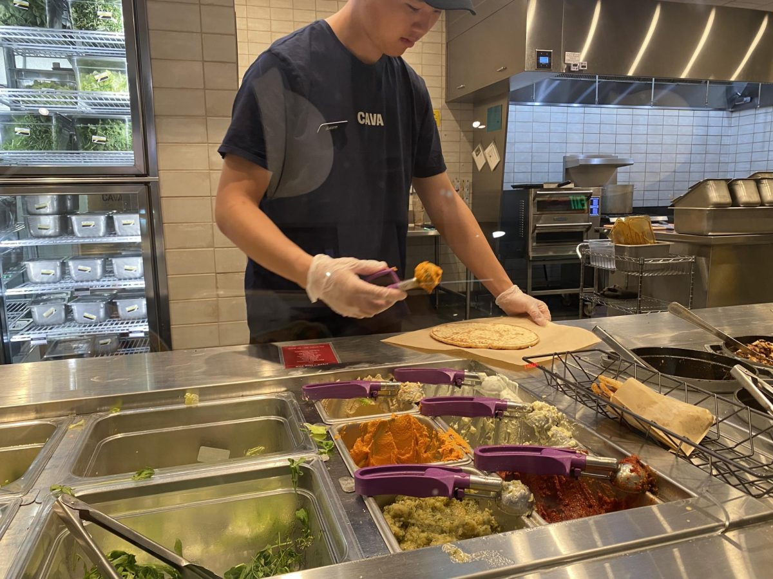
Physical Space
Space Arrangement
Entering through the front entrance you are immediately greeted with the food counter, easily able to walk up and get ordering right away, however if there is a line, you can easily take a right and enter the queue, which is marked by the barrier that allows the line to snake around the corner. From the entrance you can also see the Online Order shelf where you can quickly grab your food and leave. The entire establishment has a very linear design, first you order, then grab your drinks, then sit down with the very end of the restaurant having another exit and bathrooms.

Slide 15
Project Overview
Artifact Arrangement
People Arrangement
There are a variety of artifacts scattered throughout the establishment that guide the customer through the motions of the restaurant, especially if it’s their first time. The big menu allows customers to quickly pick a premade bowl while those who want to build their own could easily see the smaller menus stuck on the glass screen so customers can look at the toppings on both the menu and physically in front of them. Various signs allow there to be no confusion around the store as well, such as distinguishing between trash and recycling or just general warnings to not take bags without permission and to wash your hands.
The arrangement of the restaurant is designed in a way so that it’s quick and easy to navigate with few obstacles in the way. Tables and seats are along the walls so no one has to sidestep any tables. Employees are almost always only in the kitchen and assembly line so they’re usually not working out in the common areas unless for cleaning.

Slide 16
Temporal Space
The Role of Timing
Order of Events
Being a fast casual restaurant, it’s important to keep a constant flow of orders coming, hence the assembly line format they have. That’s why all toppings and food is already cooked and prepared by the cooks in the back, so the team members in the front can quickly add whatever they need to the order.
Ingredients will always be prepped ahead of time, even if all stations are stocked, cooks will keep the kitchen running smoothly in order to prevent toppings from running out. So the timeline will always go:
Prep ingredients
Build dish
Hand out to customer
Clean
Repeat

Slide 17
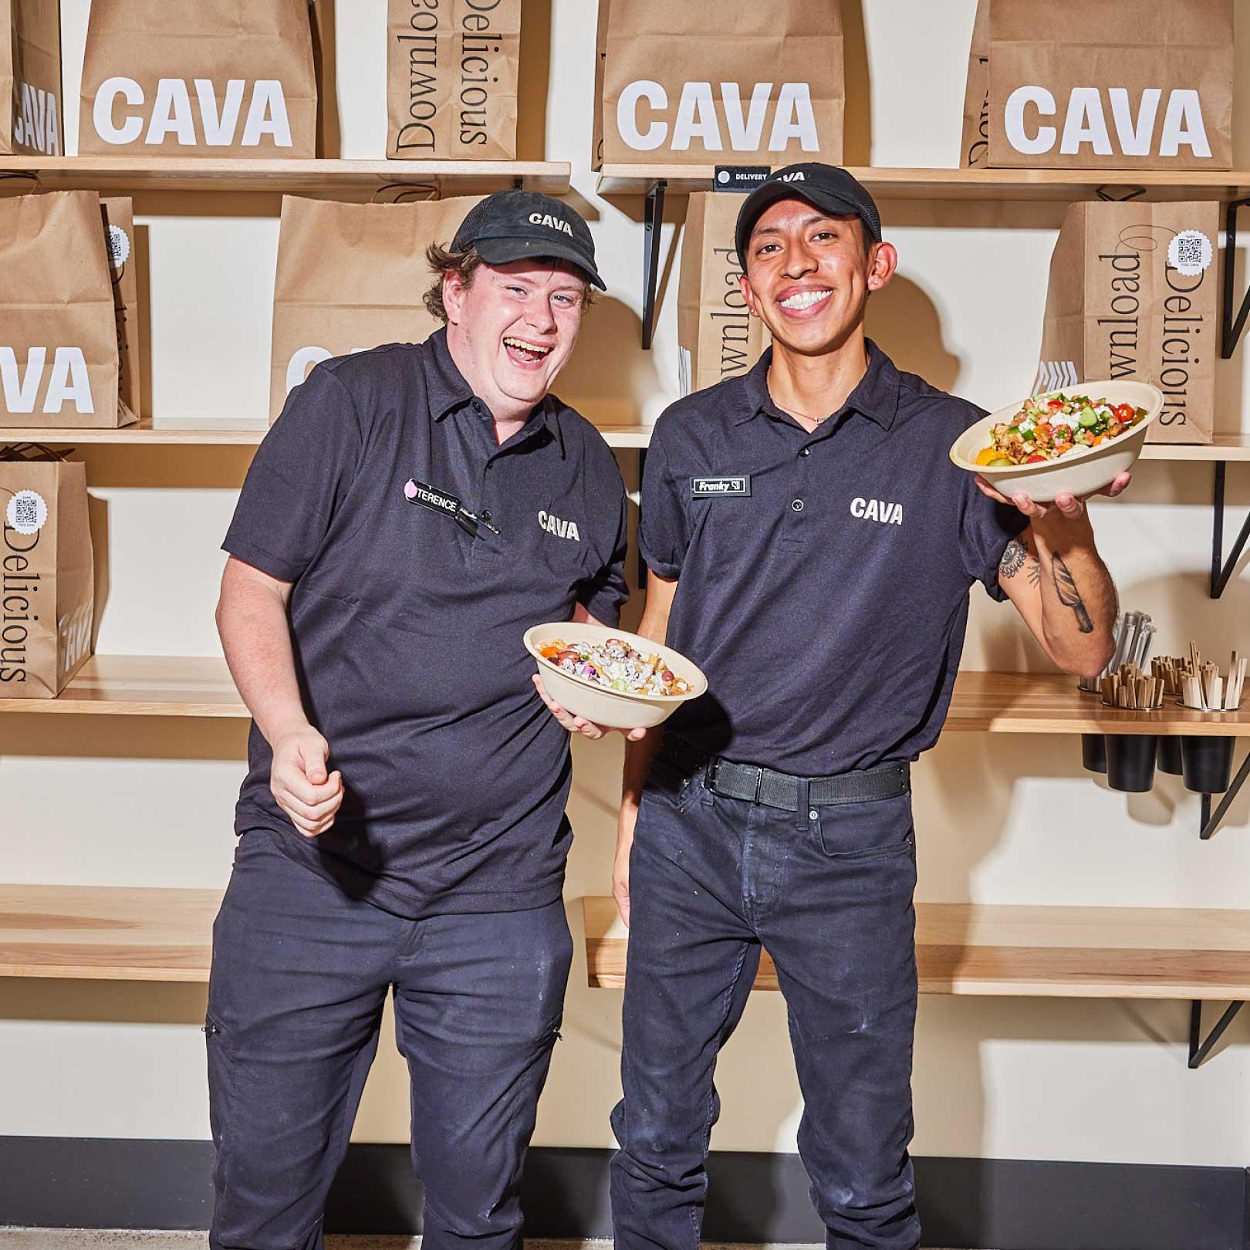
Physical Space
How does coordination happen
Not much communication really needs to be made amongst the employees, due to the assembly line fashion of the process, as long as each employee can rinse and repeat their routine then things go smoothly. Communication only really happens when passing an employee passes your bowl to the next and tells them if any extra charges should be added.

Slide 18
Propagation of Representational States
Customer
Employee
Customer peruses menu and decides what they want
Employees are prepping ingredients and maintaining kitchen
Preparation
Customer communicates order to employee
Employee receives order and assembles to customer’s wants
Production begins
Customer pays and receives their dish
Employee receives payment and hands dish to customer
Conclusion
Customer can grab a drink, sit down, or leave to eat

Slide 19
Derivation of Design
Principle of Design
Recommendation
The linear design of Cava is incredible in efficiency and aesthetic, the assembly line process can be new to many but the signs and guidelines strategically placed around the establishment allows newcomers to understand how everything works
As nice as the linear design of the establishment is, the massive pole stuck in the middle of the entire place does feel quite jarring. I understand that it’s part of the building’s structural integrity but it blocks off a path for customers to walk in and blocks out the view of the dining area from the entrance

